Slide 1

Background of game (In game shots)

Slide 2

The shadows are your friend…

Slide 3
Narrative
Add a video cycling through showing the features with footers at transitions.
Cast Aside is a rich and colourful isometric puzzle game in a 3D world based around a fallen god. That fallen god was condemned to isolation and thrown to the shadows. He has woken up thousands of years later and is learning how to control light to alter his worlds shadows, allowing him more freedom to explore, solve rooms and move forwards to his escape. By solving the various shadow and light themed puzzles and exploration the player will may unlock new cosmetics.

Slide 4
Gameplay Features
Damage from light and being able to manipulate that lights direction allows for a unique way to explore.
PUZZLES!!! Using our light and shadow manipulation mechanics the player will solve puzzles in a literal off the wall way.
Collectable heads to customise your character and add your own flavour of cute horror.
Mana managing system that will allow difficulty for the player and limit both their time in the light and rotating light sources.

Slide 5
Marketing Plan

Slide 6








Gender [1]
65% Female
35% Male
How many Game [3]
62% of British Adults
Target Demographic
By looking at the stats in the references
it can be seen that our game is well
placed to target the adult female
demographic who seems to quite enjoy
casual puzzle games. There is also an
upward trend in games for both PC
and mobile. The specific demographic
will be young adult women who play PC, have the time available to download and can play our game from the comfort of their home.
However if we port the game to mobile we may also be able to angle into the housewife demographic as well.
These stats looked at both UK and US as these will be the two best demographics for translation however could be
expanded into the EU market as well.
Age [1]
68% 25-44
32% other
Type of Play [3]
69% Casual
Genre[2]
49% of EU
females prefer
puzzle games
How they Play[4]
30% PC or Console
70% Mobile
Married[1]
67% Married
Urbanicity [1]
74% Suburban
References
[1][2][3][4]

Slide 7
Competitors & Pricing Study (Platformers)
All of our competitors share the platformer genre with us, however some have had much more success than others. This is largely down to very well designed games with solid marketing and unique mechanics, but there are some core complaints on each game.
Little Nightmares II has a very good and unique aesthetic, and the let down was the controls not being reactive at times.
Sackboy also has a very beautiful aesthetic with an extremely low player count.
It takes two requires a third party (EA/Origin) launcher and that did upset people.
Cocoons complaint was repetitive puzzles that were simply not fun.
Little Nightmares II
Price: £24.99 Lowest Price: £8.24 Sales on Steam: 1,720,000 Rating: 92% Pos
Sackboy: A Big Adventure
Price: £49.99 Lowest Price: £8.24 Sales on Steam: 117,000 Rating: 82% Pos
It Takes Two
Price: £34.99 Lowest Price: £12.24
Sales on Steam: 7,900,000 Rating: 94% Pos
Cocoon
Price: £16.79 Lowest Price: N/A
Sales on Steam: 30,000 Rating: 89% Pos
Notes:
*Units sold estimated by using the Boxleiter method at a conservative x58 to convert total reviews to sales.
*Steam Ratings were collected via SteamDB
Little Nightmares 2
Type Direct Competitor
Genre 3D platformer
Strength Fun puzzles
Weakness Control complaints
Units Sold* 1,726,090
Price £24.99 PU
Lowest Price £8.24 PU
Steam Ratings* 92% pos 30,000
Sackboy: A big Adventure
Type Direct Competitor
Genre 3D Side Scroller platformer
Strength Online co-op
Weakness Very low player count
Units Sold* 117,044
Price £49.99 PU
Lowest Price £8.24 PU
Steam Ratings* 82% pos 2,018
It Takes Two
Type Direct Competitor
Genre 3D platformer
Strength Stylised world
Weakness Requires EA Launcher
Units Sold* 7,913,346
Price £34.99 PU
Lowest Price £12.24 PU
Steam Ratings* 94% pos 136,437
Cocoon
Type Direct Competitor
Genre 3D Isometric Platformer
Strength Active Dev & Pub Team
Weakness Puzzles not fun
Units Sold* 30,856
Price £16.79 PU
Lowest Price N/A New Game
Steam Ratings* 89% pos 532

Slide 8
Competitors & Pricing Study (Shadow Mechanics)
The shadow mechanic does not seem to have much
competition when looking at it as a primary
mechanic within a game and not an ancillary
mechanic. This means we are well placed to be
at the forefront of this type of mechanic in a game
and could potentially leverage it outwards.
The large flaw with this game is the smaller
player base in most of these games, Limbo itself
being the exception to this and largely because the
shadow is not just a mechanic but also its unique art
style and it had a very strong marketing effort.
That said people do seem to enjoy the unique mechanics these games offer. Schim is also likely to be a frontline competitor to us
In the near future with their unique bounding shadow puzzle mechanic.
Schim
Price: N/A Lowest Price: N/A Sales on Steam: N/A Rating: N/A
In My Shadow
Price: £8.00 Lowest Price: £2.00 Sales on Steam: 3,600 Rating: 74%
Shady Part of Me
Price: £12.99 Lowest Price: £2.59
Sales on Steam: 93,000 Rating: 90% Pos
Limbo
Price: £8.99 Lowest Price: £0.69
Sales on Steam: 2,800,000 Rating: 91% Pos
Notes:
*Units sold estimated by using the Boxleiter method at a conservative x58 to convert total reviews to sales.
*Steam Ratings were collected via SteamDB
Schim
Type Direct Competitor
Genre Adventure/Casual/Indie
Strength Very unique art style
Weakness Small Dev/Pub
Units Sold* Upcoming release
Price N/A
Lowest Price N/A
Steam Ratings* N/A
In My Shadow
Type Direct Competitor
Genre Adventure/Casual/Indie
Strength Enjoyable indie game
Weakness >5 current player count
Units Sold* 3,654
Price £8.00 PU
Lowest Price £2.00 PU
Steam Ratings* 74% pos 63
Shady Part of Me
Type Direct Competitor
Genre Indie
Strength Love the music
Weakness Puzzles were simple
Units Sold* 93,612
Price £12.99 PU
Lowest Price £2.59 PU
Steam Ratings* 90% pos 1,614
Limbo
Type Direct Competitor
Genre Action/Adventure/Indie
Strength Hard but fair
Weakness Lack of clues/Help
Units Sold* 2,829,878
Price £8.99 PU
Lowest Price £0.69 PU
Steam Ratings* 91% pos 48,791

Slide 9
Production Timeline
July 2024
October 2024
November 2024
December 2024
August 2024
September 2024
1 New level (b1)
2 New characters
2 New puzzles
1 New level (b1)
2 New characters
2 New puzzles
1 New level
2 New puzzles
1 New biome (b2)
2 New characters
1 New level (b2)
2 New characters
2 New puzzles
Early Access
2 New characters
1 New puzzle
1 New level (b2)
EA Bug Fixing
1 New puzzle
Start new biome (b3)

Slide 10
Budget
To sort the budget the first cost is the cost of the current
team of which will be the bulk of our cost at a flat rate
of £2,500 each.
The next part to add is licensing that will be required at
the moment this is just photoshop, which would cost £80
for 4 seats.
Should we make more than $200,000 through sales we
will need to upgrade our unity license to Unity Pro which
would cost an additional £6,562 for 4 seats PA.
Localisation will cost approximately £0.13 per word.
Game Development Burn rate: £10,080 per month
Music and Sound:
QA:
PR + Marketing:
Porting:
Localisation: Approx GBP 0.12-0.15 per word [6]
Additional costs: £6,562

Slide 11
Funding

Slide 12
Unique Selling Point
We believe we are well placed to create this game.
The unique mechanics relying on shadow manipulation
is not a common primary mechanic seen in games.
This means we have a vast opportunity to carve a
path in this mechanic based puzzle genre, and with
our target demographic in mind we are very well
situated to utilise this area.
We believe with the support of an effective partner
We can bring this unique game to the market and
create an engaging experience players will enjoy
and keep playing through till completion.

Slide 13
Looking For
Development Funding
Store Support
Marketing Support
A partner who understands us and our game

Slide 14

Developer
2023
Cartoon RPG’s & platformers
Cyberpunk & Sci Fi RPG’s

Slide 15

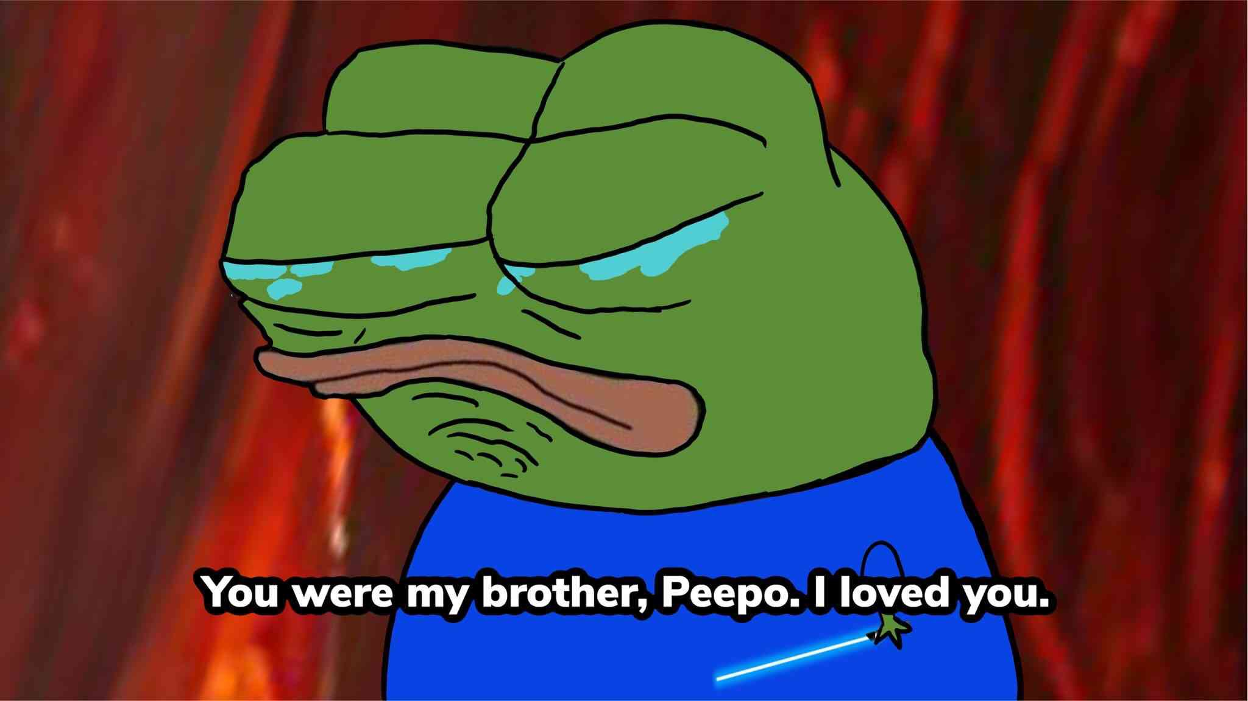
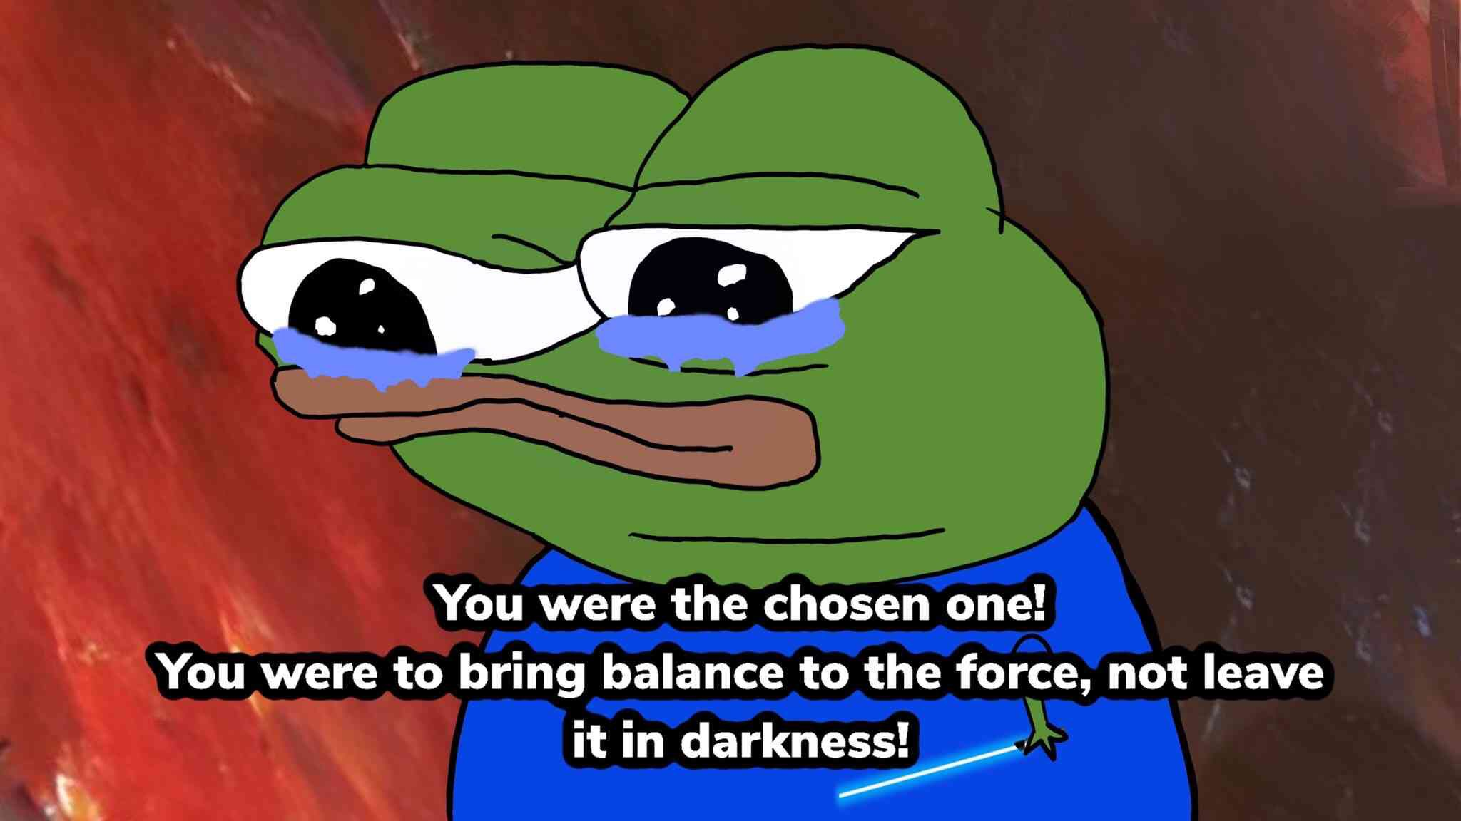
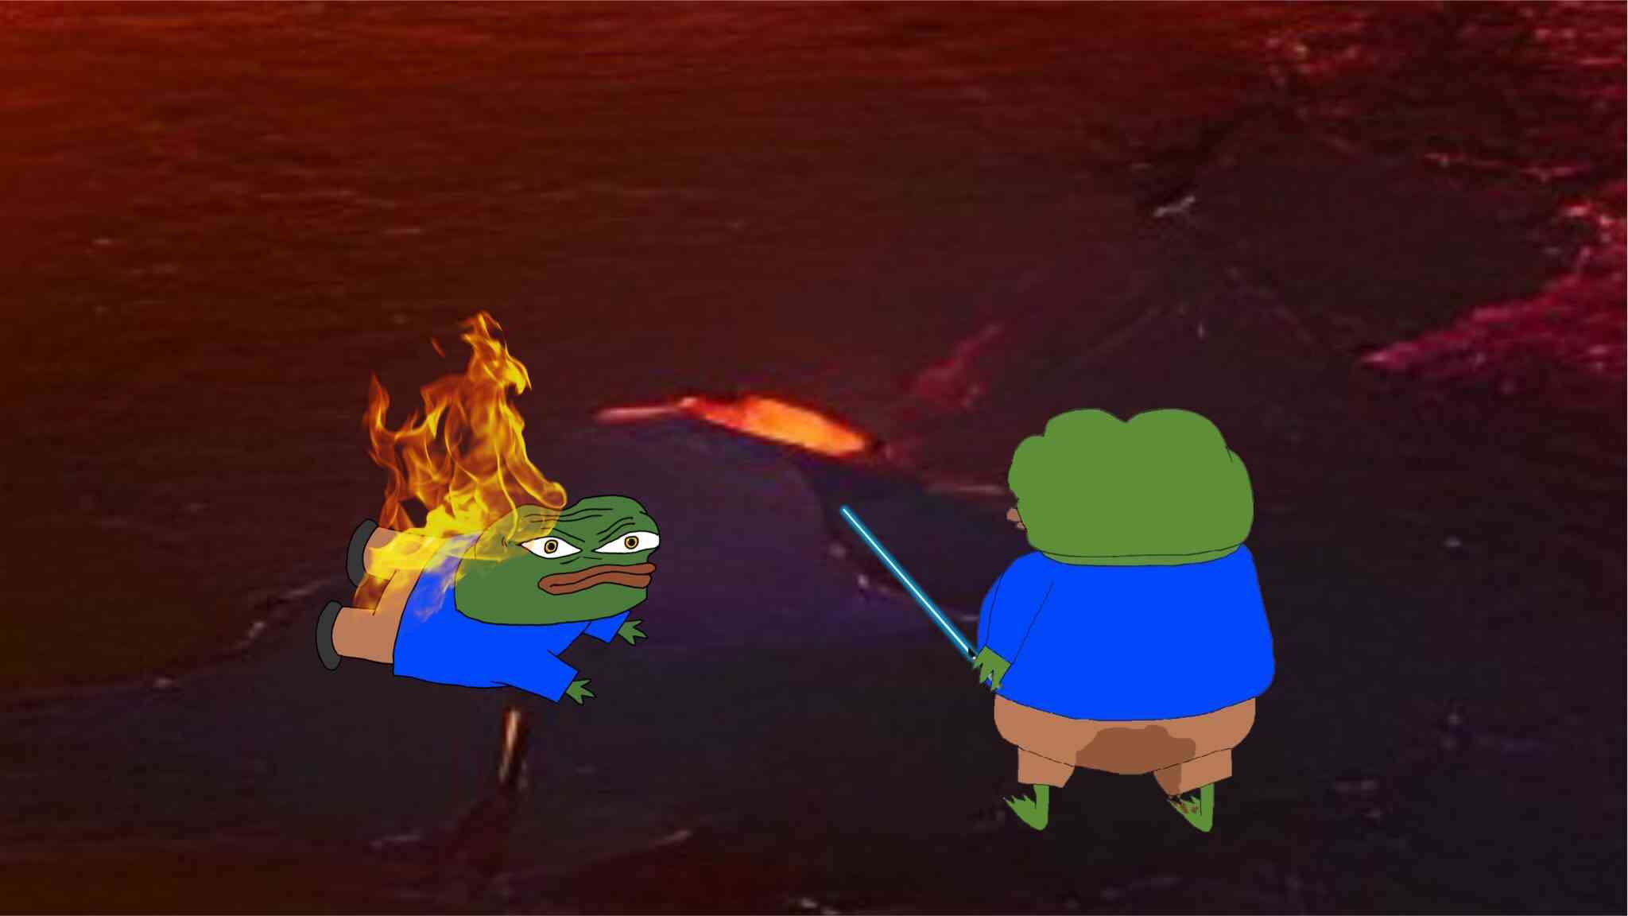
The Team
Mike Project Lead
Game designer who enjoys making 3D character art and Animations.
Adam Programmer
Very good at proc gen, code organisation, and effects.
Richard Programmer
Enjoys programming and off hands as a 2D artist for menus and UI’s.
Tom Game Designer
Knows how to weave narratives and design levels to engage the player.

Slide 16
Thankyou for your time
S239104@UOS.AC.UK

Slide 17
End of Presentation

